Slide 1
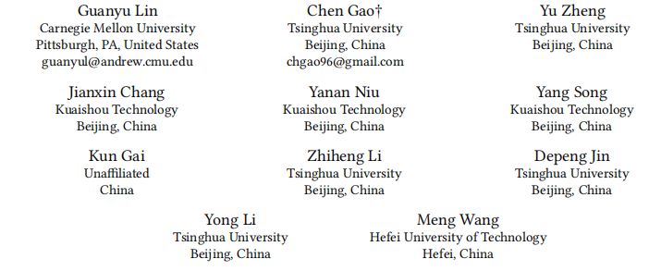
ATAI
Advanced Technique of Artificial Intelligence
ATAI
ChongqingUniversity _{AdvancedTechniqueof}
of Technology Artificial Intelligence
Chongqing University of
Technology
Chongqing University ^{ATAI}
_{of Technology} Advanced Techniqueof
Artificial Intelligence
Chongqing University of Technology
Chongqing University of Technology
Mixed Attention Network for Cross-domain Sequential
Recommendation
Code : https://github.com/Guanyu-Lin/MAN
—— WSDM2024
Reported by Jing Li
1

Slide 2
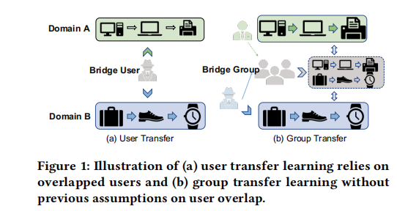
ATAI
Advanced Technique of Artificial Intelligence
ATAI
ChongqingUniversity _{AdvancedTechniqueof}
of Technology Artificial Intelligence
Chongqing University of
Technology
Chongqing University ^{ATAI}
_{of Technology} Advanced Techniqueof
Artificial Intelligence
Chongqing University of Technology
Chongqing University of Technology
Introduction
Particularly, a few early attempts were proposed to achieve cross-domain sequential recommendation, which leverages cross-domain technique to address the data sparsity of sequential modeling,these methods rely heavily on the overlapped users , which is hardly satisfied in practical scenarios. In fact, in many real-world applications, users are not overlapping across different domains .Thus, it is challenging for the existing cross-domain sequential recommendation to work in real-world scenarios.

Slide 3
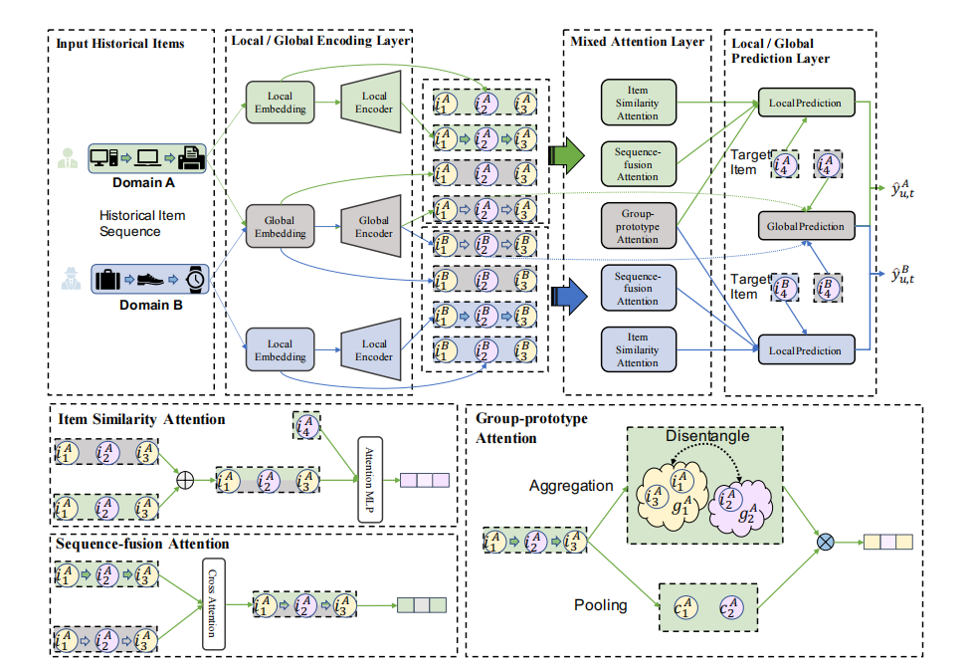
ATAI
Advanced Technique of Artificial Intelligence
ATAI
ChongqingUniversity _{AdvancedTechniqueof}
of Technology Artificial Intelligence
Chongqing University of
Technology
Chongqing University ^{ATAI}
_{of Technology} Advanced Techniqueof
Artificial Intelligence
Chongqing University of Technology
Chongqing University of Technology
Overview

Slide 4
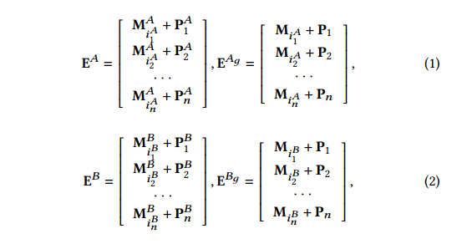
ATAI
Advanced Technique of Artificial Intelligence
ATAI
ChongqingUniversity _{AdvancedTechniqueof}
of Technology Artificial Intelligence
Chongqing University of
Technology
Chongqing University ^{ATAI}
_{of Technology} Advanced Techniqueof
Artificial Intelligence
Chongqing University of Technology
Chongqing University of Technology
Method

Slide 5
ATAI
Advanced Technique of Artificial Intelligence
ATAI
ChongqingUniversity _{AdvancedTechniqueof}
of Technology Artificial Intelligence
Chongqing University of
Technology
Chongqing University ^{ATAI}
_{of Technology} Advanced Techniqueof
Artificial Intelligence
Chongqing University of Technology
Chongqing University of Technology
Method

Slide 6
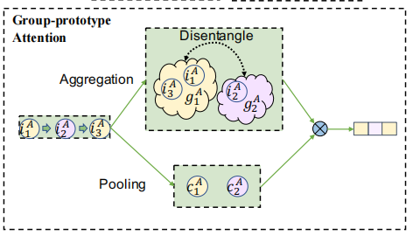
ATAI
Advanced Technique of Artificial Intelligence
ATAI
ChongqingUniversity _{AdvancedTechniqueof}
of Technology Artificial Intelligence
Chongqing University of
Technology
Chongqing University ^{ATAI}
_{of Technology} Advanced Techniqueof
Artificial Intelligence
Chongqing University of Technology
Chongqing University of Technology
Method

Slide 7
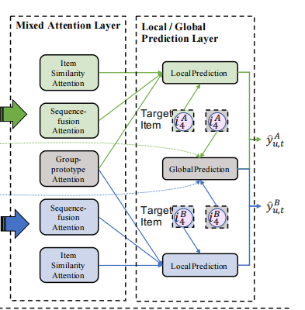
ATAI
Advanced Technique of Artificial Intelligence
ATAI
ChongqingUniversity _{AdvancedTechniqueof}
of Technology Artificial Intelligence
Chongqing University of
Technology
Chongqing University ^{ATAI}
_{of Technology} Advanced Techniqueof
Artificial Intelligence
Chongqing University of Technology
Chongqing University of Technology
Method

Slide 8
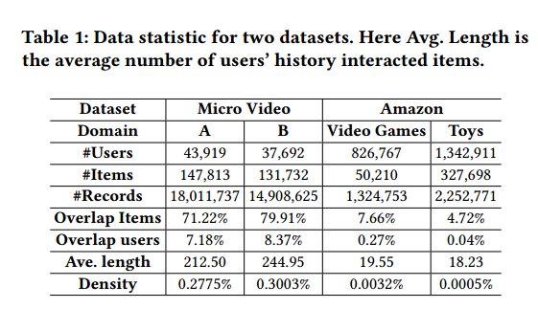
ATAI
Advanced Technique of Artificial Intelligence
ATAI
ChongqingUniversity _{AdvancedTechniqueof}
of Technology Artificial Intelligence
Chongqing University of
Technology
Chongqing University ^{ATAI}
_{of Technology} Advanced Techniqueof
Artificial Intelligence
Chongqing University of Technology
Chongqing University of Technology
Experiments

Slide 9
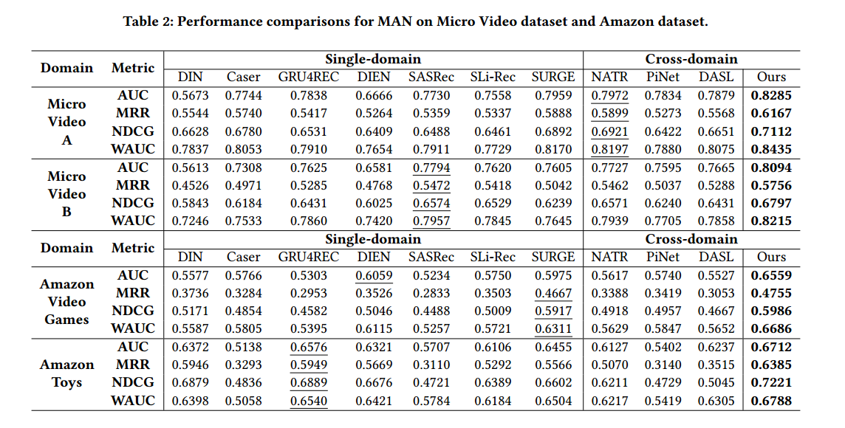
ATAI
Advanced Technique of Artificial Intelligence
ATAI
ChongqingUniversity _{AdvancedTechniqueof}
of Technology Artificial Intelligence
Chongqing University of
Technology
Chongqing University ^{ATAI}
_{of Technology} Advanced Techniqueof
Artificial Intelligence
Chongqing University of Technology
Chongqing University of Technology
Experiments

Slide 10
ATAI
Advanced Technique of Artificial Intelligence
ATAI
ChongqingUniversity _{AdvancedTechniqueof}
of Technology Artificial Intelligence
Chongqing University of
Technology
Chongqing University ^{ATAI}
_{of Technology} Advanced Techniqueof
Artificial Intelligence
Chongqing University of Technology
Chongqing University of Technology
Experiments

Slide 11
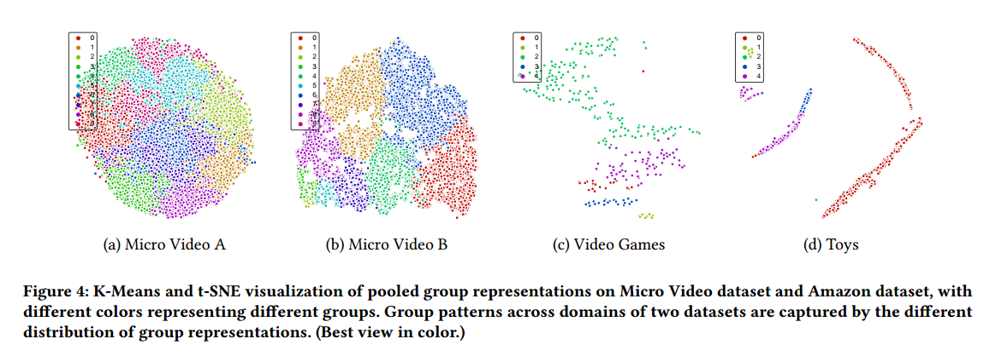
ATAI
Advanced Technique of Artificial Intelligence
ATAI
ChongqingUniversity _{AdvancedTechniqueof}
of Technology Artificial Intelligence
Chongqing University of
Technology
Chongqing University ^{ATAI}
_{of Technology} Advanced Techniqueof
Artificial Intelligence
Chongqing University of Technology
Chongqing University of Technology
Experiments

Slide 12
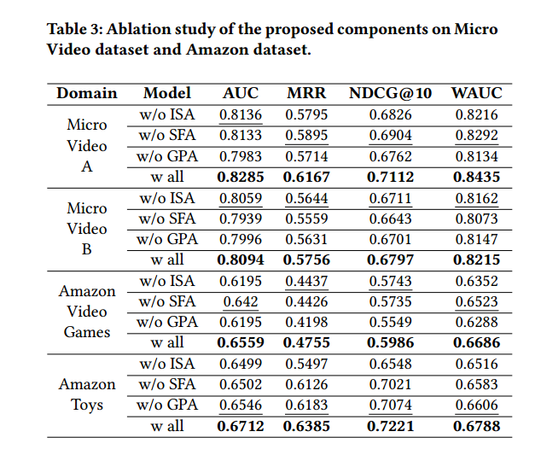
ATAI
Advanced Technique of Artificial Intelligence
ATAI
ChongqingUniversity _{AdvancedTechniqueof}
of Technology Artificial Intelligence
Chongqing University of
Technology
Chongqing University ^{ATAI}
_{of Technology} Advanced Techniqueof
Artificial Intelligence
Chongqing University of Technology
Chongqing University of Technology
Experiments

Slide 13
ATAI
Advanced Technique of Artificial Intelligence
ATAI
ChongqingUniversity _{AdvancedTechniqueof}
of Technology Artificial Intelligence
Chongqing University of
Technology
Chongqing University ^{ATAI}
_{of Technology} Advanced Techniqueof
Artificial Intelligence
Chongqing University of Technology
Chongqing University of Technology
Thanks!

